Slide 1

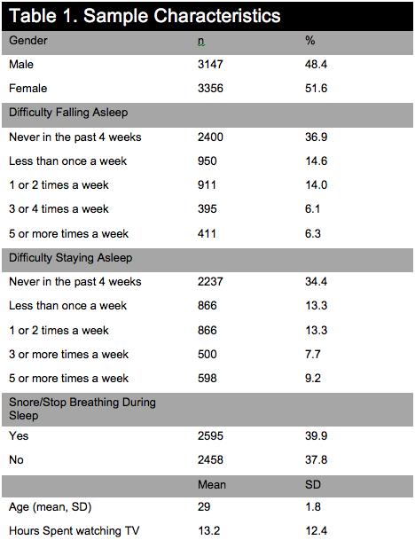
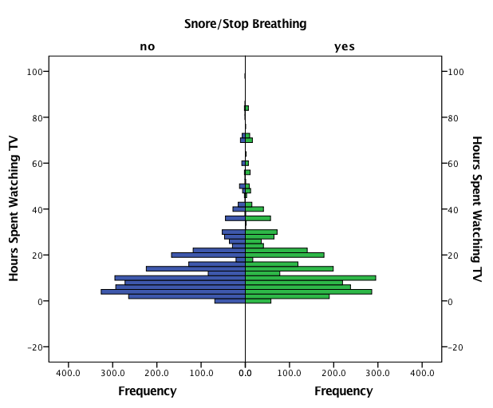
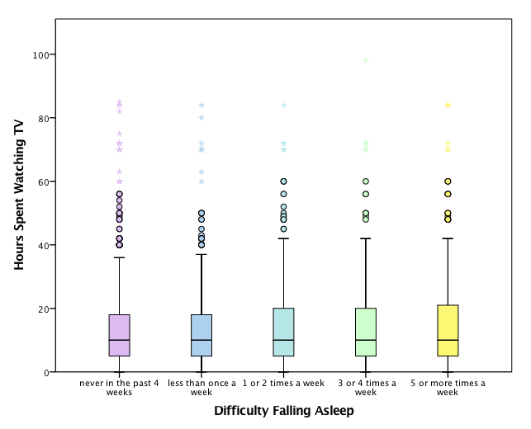
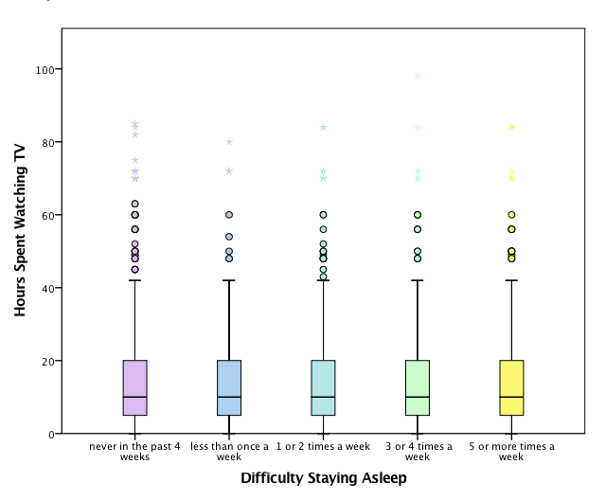
Associations Between Hours Spent Watching TV and Sleep Quality
Hsuan, Annie
Abstract
Objective: This study examined associations between hours spent watching TV and overall sleep quality in adults.
Methods: Data was obtained from AddHealth codebook: Wave IV In-Home Interview. The sections used for the purpose of this research were “Daily Activities” and “Sleep Patterns”
Results: It was found that males watch on average more hours of TV than females, and individuals experiencing lower incidences of difficulty falling asleep watched less hours of TV than those experiencing higher incidences of difficulty falling asleep (p=.000).
Conclusion: Based on the evidence, it can be concluded that more hours spent watching TV corresponds to a higher frequency of difficulty falling asleep in adults.
Introduction
With insomnia becoming a more prominent issue in our society today, individuals are constantly seeking out ways to improve their sleep quality¹. A high quality night of sleep is what most individuals strive for in order to wake up in the morning feeling refreshed. Lack of sleep can cause many mental and physical issues. It can decrease productivity throughout the day and cause people to be lethargic. A wide array of factors can contribute to overall sleep quality, but with technology becoming more and more used in the modern world, it is becoming one of the emerging factors that affect sleep quality². Individuals spend increasing amounts of time watching TV and on their computers, so this study strives to investigate the affects of TV on sleep quality.
Hypotheses
Individuals watching more hours of TV will experience higher incidences of difficulty falling asleep.
Individuals watching more hours of TV will experience higher incidences of difficulty staying asleep.
Individuals who snore/stop breathing during sleep watch on average more hours of TV than those who do not.
Sample Characteristics
Results
Figure 1.
Figure 1 illustrates the hours spent watching TV among individuals who snore/stop breathing during sleep and those who do not experience this.
The independent t-test showed that individuals who do tend to snore or stop breathing during their sleep watch on average more hours of television (14.27 ± 13.1 hours) compared to those who do not snore or stop breathing during sleep (12.36 ± 11.7 hours), p = .000
Figure 2.
Figure 2 illustrates associations between difficulty falling asleep and hours spent watching TV.
Individuals who have “never in the past 4 weeks” had difficulty falling asleep spent on average less hours watching TV (12.5 ± 11.6 hours) compared to those who had difficulty falling asleep “3 or 4 times per week” (14.7 ± 14.6 hours) and “5 or more times per week” (16.7 ± 16.5 hours), p = .000
Individuals who have had difficulty falling asleep “less than once a week” spent on average less hours watching TV (12.76 ± 11.0 hours) than those who had difficulty falling asleep “5 or more times per week” p =.000
Individuals who had difficulty falling asleep “1 or 2 times per week” spent on average less hours watching TV (13.8 ± 12.7 hours) than those who had difficulty falling asleep “5 or more times per week” p = .001.
Methods
All data was obtained from AddHealth: Wave IV In-Home Interviews. Sections used for the purpose of this study includes: “Daily Activities” and “Sleep Patterns”
Variables used:
Gender (Male/Female)
Difficulty falling asleep (ranges from “never in the past 4 weeks” to “5 or more times a week”)
Difficulty staying asleep (ranges from “never in the past 4 weeks” to “5 or more times a week”)
Hours spent watching TV in a week
Snore/stop breathing during sleep (Yes/No)
Statistical Analysis:
ANOVA test to compare differences in hours of TV watched among the different levels of difficulty falling asleep.
ANOVA test to compare differences in hours of TV watched among the different levels of difficulty staying asleep.
Independent t-test to compare mean hours of TV watched between those who do snore/stop breathing during sleep and those who do not.
Data was analyzed using IBM Statistical Package for the Social Science [SPSS Statistics] version 24. Results were considered statistically significant if the p-value obtained was less than 0.5. Descriptive statistics were used to characterize the general demographic characteristics of the sample and survey responses.
Figure 3.
Figure 3 illustrates associations between difficulty staying asleep and hours spent watching TV.
Individuals who have had difficulty staying asleep “less than once a week” spent on average less hours watching TV (12.27 ± 9.9 hours) than those who had difficulty staying asleep “5 or more times per week” (14.67 ± 14.4 hours). P = .003.
Conclusions/Implications:
Overall, the analysis showed significant associations between sleep quality and hours spent watching television. Individuals who have more difficulty falling asleep tend to watch on average more hours of TV. Individuals who snore/stop breathing during their sleep also watch more hours of TV compared to those who do not.
Implications:
Individuals who may have difficulty falling asleep or experience insomnia frequently may want to reduce the amount of time they spend watching television.
Future research could look at the associations of other variables related to sleep patterns such as caffeine intake, exercise, or diet. Another interesting relationship to look at would be an individual’s job setting and their sleep patterns.
References
1. Li, J., Varrasse, M., Gooneratne, N. (2015). Exercise and Sleep in Community-Dwelling Older Adults. Sleep Epidemiology, 1:232-240.
2. Passos GS, Poyares D, Santana MG, D’Aurea CV, Youngstedt SD, Tufik S, et al. Effects of moderate aerobic exercise training on chronic primary insomnia. Sleep Med. 2011;12(10):1018–27.
3. Baron, K. G., Reid, K. J., & Zee, P. C. (2013). Exercise to Improve Sleep in Insomnia: Exploration of the Bidirectional Effects. Journal of Clinical Sleep Medicine : JCSM : Official Publication of the American Academy of Sleep Medicine, 9(8), 819–824

